Slide 1

Be a Star
7/24 - 7/27

Slide 2

How do I become a YouTube Star?
Answer
=
Design Thinking!

Slide 3
Camp Objectives
Design Thinking
Learn to Create/Manage a Channel
Make Videos!
Attract an Audience
Review Your Channel
Keep making your channel awesome!

Slide 4
YouTube Camp
Day One

Slide 5
Objectives: Day One of YouTube Camp
Idea Brainstorm
Design Thinking Exercise
Branding
Come up with idea for your YouTube content
Create Your YouTube channel
Create a Thumbnail
Create a Banner

Slide 6

Brainstorm
Ideas

Slide 7

What are your talents?
What talent do you want to share with the world?
Who is your target audience?
Notes:
Have students fill out as much as they can on the “Initial Brainstorm Activity”

Slide 8
Design Thinking Exercise

Slide 9
First, as a class
We’ll watch a YouTube video and discuss feedback as a class

Slide 10
Design Thinking
Exercise
Choose 3
Timed 4 minutes each
Use handout to record what you like and don’t like about each
Preparing the plan

Slide 11

Branding

Slide 12
Branding
Focus on the talent you want to share with the world
Guidance or advice you want to share
What are you/your videos all about?

Slide 13

Create Your YouTube Channel

Slide 14
Create a Name for Your Channel
Simple and Easy to Remember
The name relates to the kind of videos you’ll make
If your name is already taken, create an alias or an alias name related to your content

Slide 15
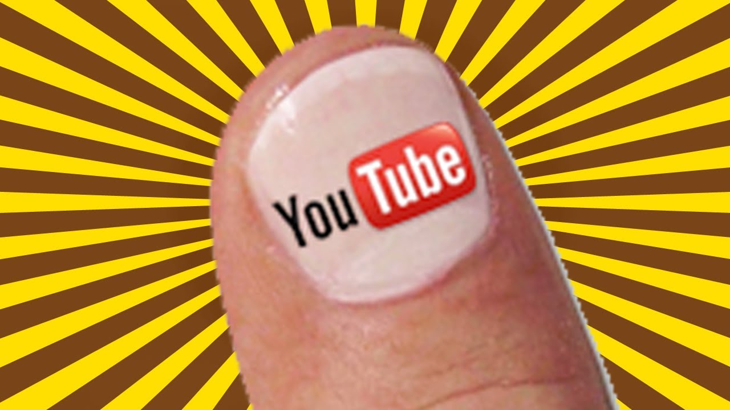
Create Your Channel’s Thumbnail

Slide 16
Your Channel Thumbnail
One of the most important visuals
This is what people will initially see
Should attract users to your channel
Colorful pictures/photos with high contrast

Slide 17
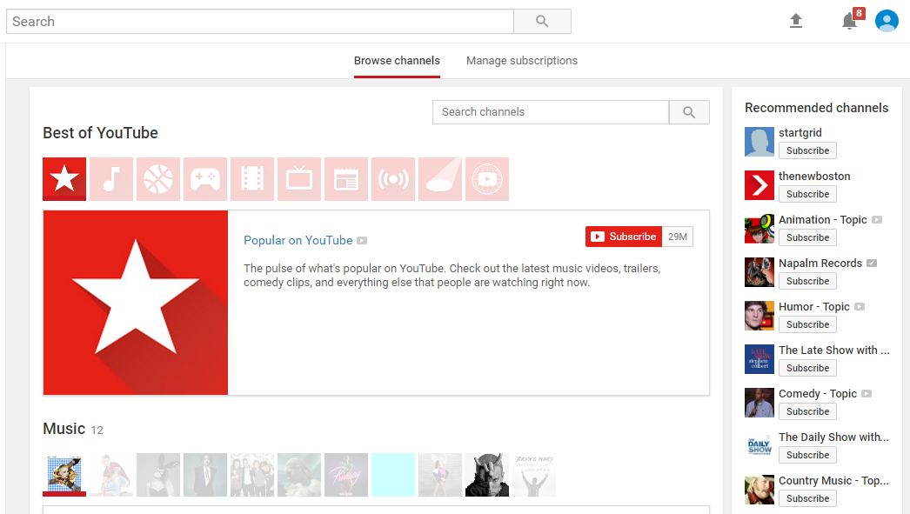
How YouTubers See Thumbnails

Slide 18
Create a Banner

Slide 19
How to make a good banner
Most dominant image on your page
Relates to the tone of your videos
Many people include their username in their banners

Slide 20
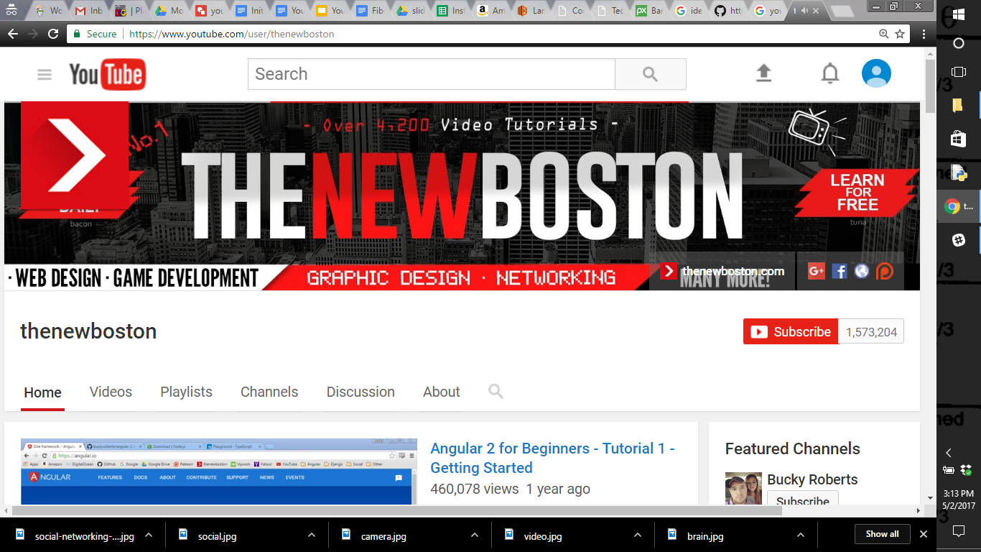
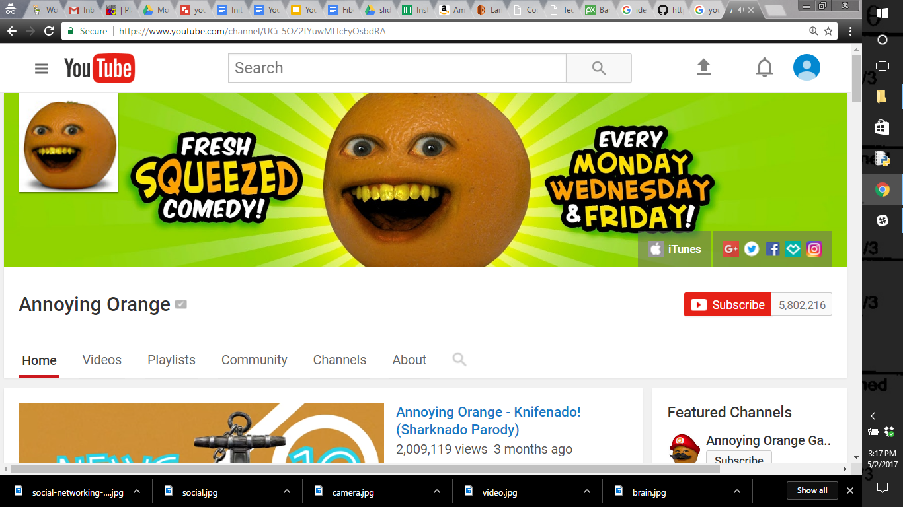
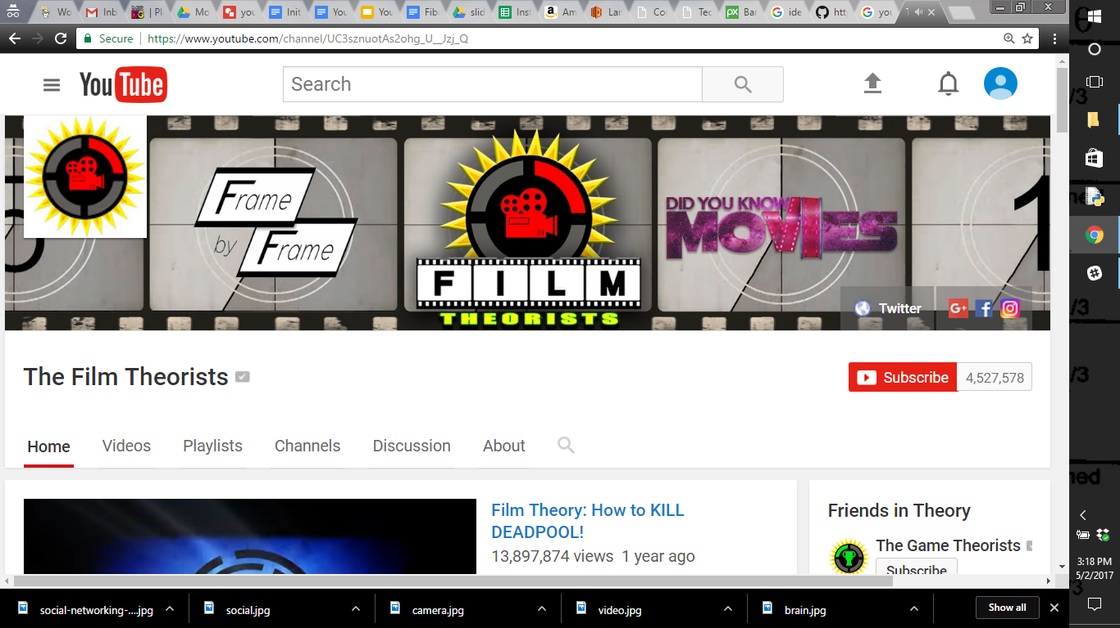
Good Banners

Slide 21
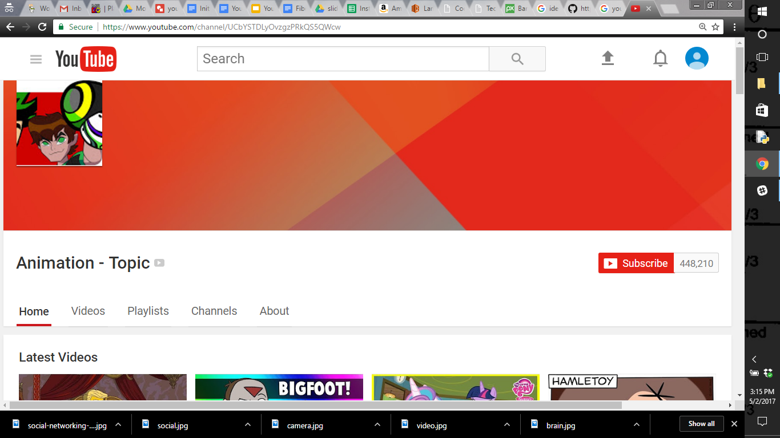
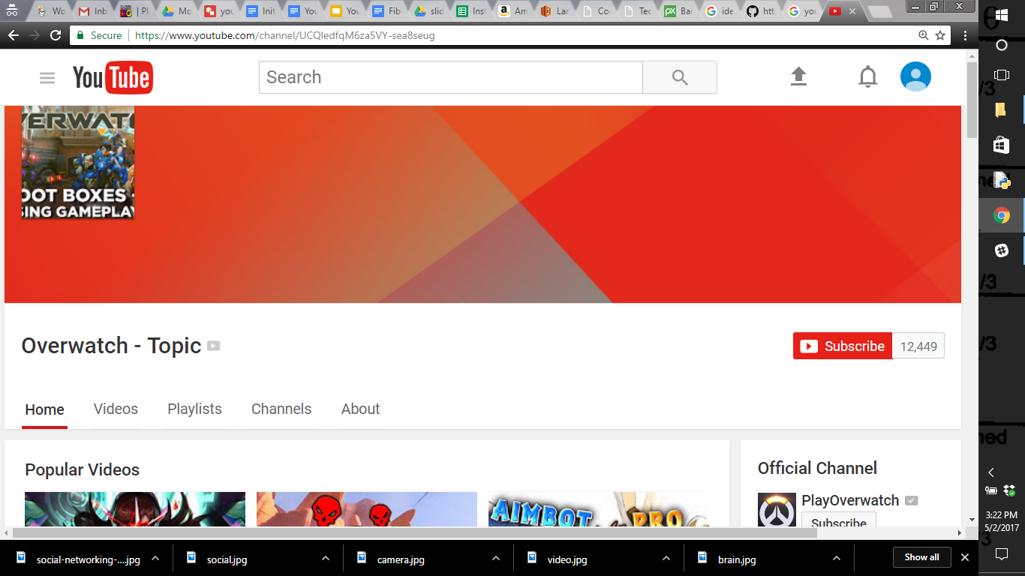
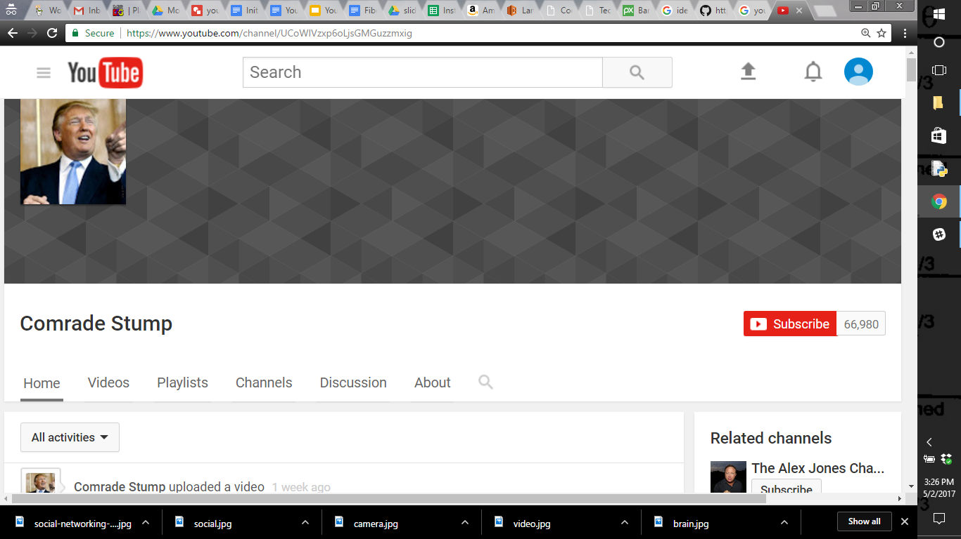
Banners that are too plain

Slide 22

Make Your Videos!

Slide 23
Making Videos
Make an outline for your video BEFORE you start filming
This will help keep your video from being too long and not making sense.
Edit your video
Upload your video
Try to consistently upload videos
Good idea to make an intro/outro for all of your videos
T.V. shows usually have theme songs/intros

